Slide 1

Compression IOI
by Uğur Çayoğlu 13. February 2020
STEINBUCH CENTRE FOR COMPUTING (SCC) & INSTITUTE FOR METEOROLOGY AND CLIMATE RESEARCH (IMK-ASF)
KIT - The Research University in the Helmholtz Association
www.kit.edu

Slide 2

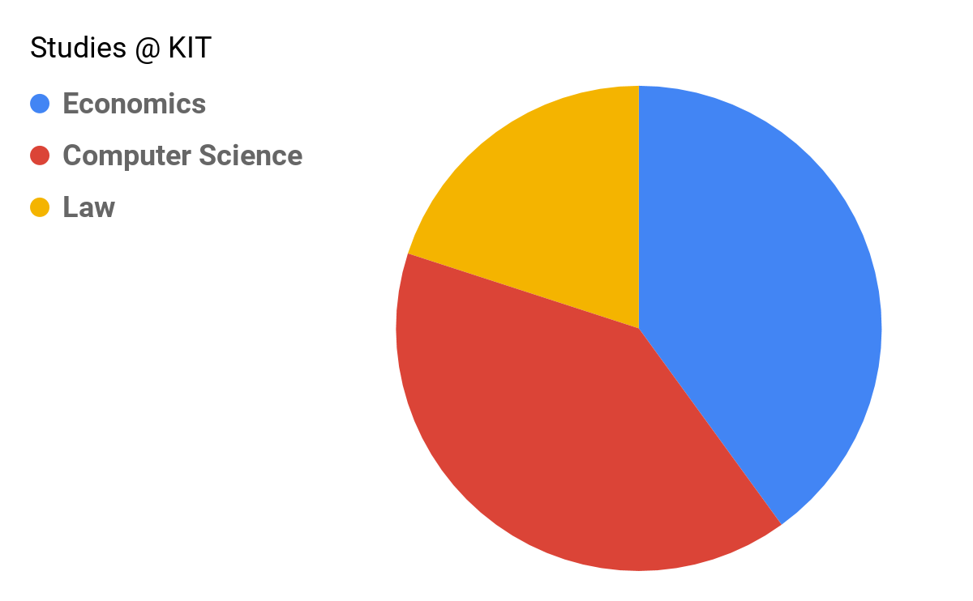
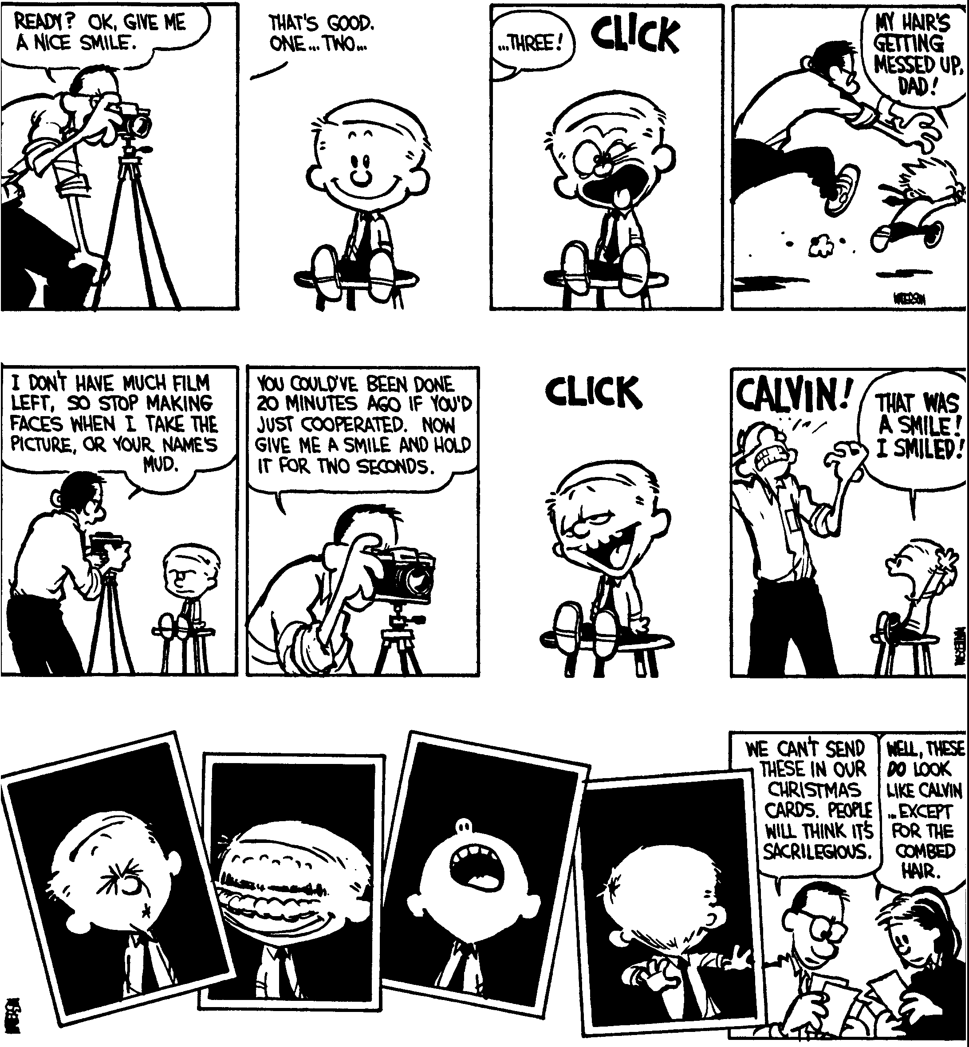
Me, myself and I
Studied Information Management and Engineering @ KIT
<number>
STEINBUCH CENTRE FOR COMPUTING (SCC) INSTITUTE FOR METEOROLOGY AND CLIMATE RESEARCH (IMK-ASF)
Breakfast Meeting on 2020/02/13 by Ugur Cayoglu

Slide 3
Me, myself and I
Studied Information Management and Engineering @ KIT
Bachelor thesis:
Improve Collaboration Between Marketing and Sales and Analyze the Impact on the Quality of Customer Data in the Enterprise
<number>
STEINBUCH CENTRE FOR COMPUTING (SCC) INSTITUTE FOR METEOROLOGY AND CLIMATE RESEARCH (IMK-ASF)
Breakfast Meeting on 2020/02/13 by Ugur Cayoglu

Slide 4
Me, myself and I
Master thesis:
Conceptualization and Prototypical Implementation of a Tool to Determine the Optimal XML Similarity Measurement
Doctoral thesis:
Compression Methods for Structured Floating Point Data and their Application in Climate Research
<number>
STEINBUCH CENTRE FOR COMPUTING (SCC) INSTITUTE FOR METEOROLOGY AND CLIMATE RESEARCH (IMK-ASF)
Breakfast Meeting on 2020/02/13 by Ugur Cayoglu

Slide 5
History
Compression has its origin in communication technology
Hence compression == source coding
(Unreliable) Channel
Source
Sink
<number>
STEINBUCH CENTRE FOR COMPUTING (SCC) INSTITUTE FOR METEOROLOGY AND CLIMATE RESEARCH (IMK-ASF)
Breakfast Meeting on 2020/02/13 by Ugur Cayoglu

Slide 6
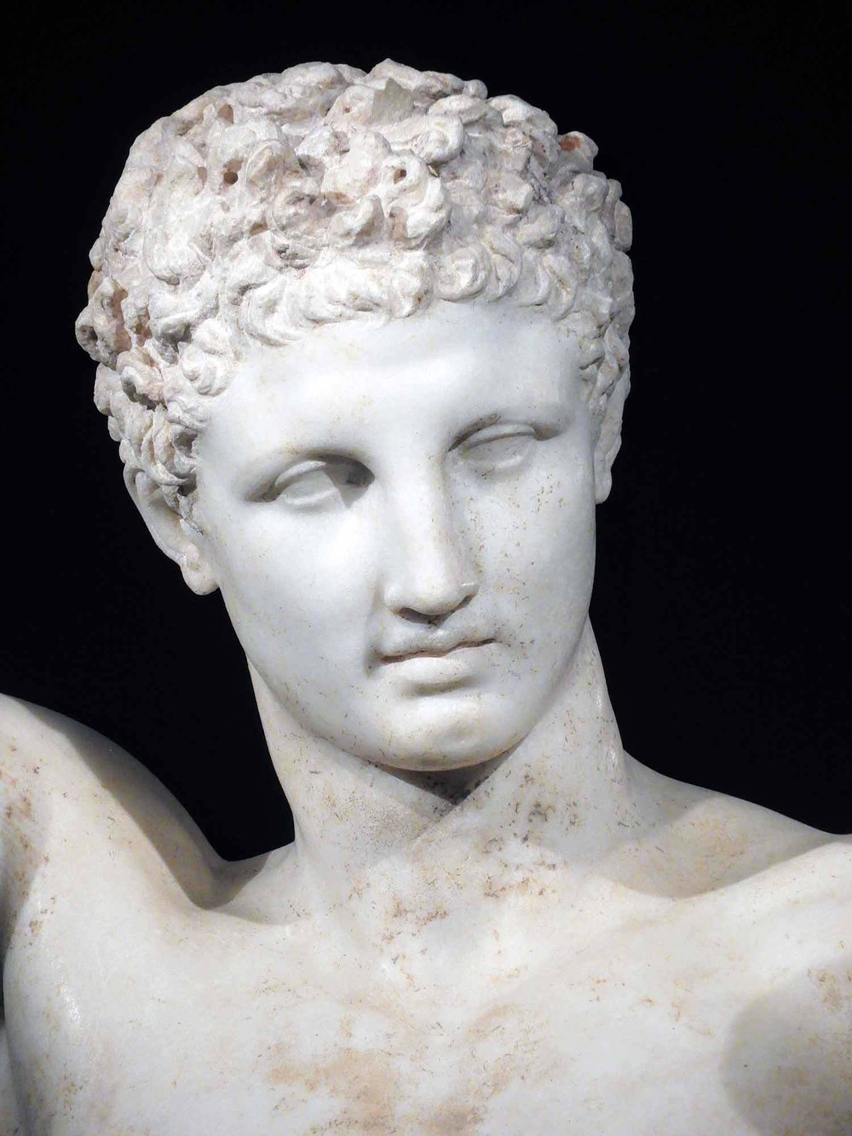
Compression IOI
Source [A]
<number>
STEINBUCH CENTRE FOR COMPUTING (SCC) INSTITUTE FOR METEOROLOGY AND CLIMATE RESEARCH (IMK-ASF)
Breakfast Meeting on 2020/02/13 by Ugur Cayoglu

Slide 7
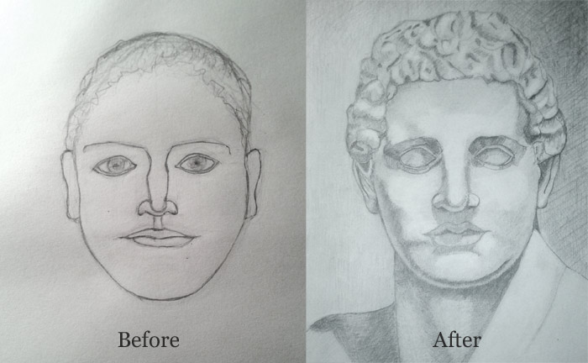
Compression IOI
Source [B]
<number>
STEINBUCH CENTRE FOR COMPUTING (SCC) INSTITUTE FOR METEOROLOGY AND CLIMATE RESEARCH (IMK-ASF)
Breakfast Meeting on 2020/02/13 by Ugur Cayoglu

Slide 8
Compression IOI
<number>
STEINBUCH CENTRE FOR COMPUTING (SCC) INSTITUTE FOR METEOROLOGY AND CLIMATE RESEARCH (IMK-ASF)
Breakfast Meeting on 2020/02/13 by Ugur Cayoglu

Slide 9
Compression IOI
<number>
STEINBUCH CENTRE FOR COMPUTING (SCC) INSTITUTE FOR METEOROLOGY AND CLIMATE RESEARCH (IMK-ASF)
Breakfast Meeting on 2020/02/13 by Ugur Cayoglu

Slide 10
Compression IOI
<number>
STEINBUCH CENTRE FOR COMPUTING (SCC) INSTITUTE FOR METEOROLOGY AND CLIMATE RESEARCH (IMK-ASF)
Breakfast Meeting on 2020/02/13 by Ugur Cayoglu

Slide 11
Compression IOI
Lossless compression
<number>
STEINBUCH CENTRE FOR COMPUTING (SCC) INSTITUTE FOR METEOROLOGY AND CLIMATE RESEARCH (IMK-ASF)
Breakfast Meeting on 2020/02/13 by Ugur Cayoglu

Slide 12
Compression IOI
Lossy compression
Source [B]
<number>
STEINBUCH CENTRE FOR COMPUTING (SCC) INSTITUTE FOR METEOROLOGY AND CLIMATE RESEARCH (IMK-ASF)
Breakfast Meeting on 2020/02/13 by Ugur Cayoglu

Slide 13
Nomenclature
Original data
Encoded data
Decoded data
<number>
STEINBUCH CENTRE FOR COMPUTING (SCC) INSTITUTE FOR METEOROLOGY AND CLIMATE RESEARCH (IMK-ASF)
Breakfast Meeting on 2020/02/13 by Ugur Cayoglu

Slide 14
Nomenclature
Size of original data
Size of encoded data
Original data
Encoded data
Decoded data
<number>
STEINBUCH CENTRE FOR COMPUTING (SCC) INSTITUTE FOR METEOROLOGY AND CLIMATE RESEARCH (IMK-ASF)
Breakfast Meeting on 2020/02/13 by Ugur Cayoglu

Slide 15
Nomenclature
Size of original data
Size of encoded data
Original data
Encoded data
Decoded data
Size of encoded data
Compression Factor
[no dimension]
Size of original data
<number>
STEINBUCH CENTRE FOR COMPUTING (SCC) INSTITUTE FOR METEOROLOGY AND CLIMATE RESEARCH (IMK-ASF)
Breakfast Meeting on 2020/02/13 by Ugur Cayoglu

Slide 16
Nomenclature
Encoding time
Decoding time
Original data
Encoded data
Decoded data
<number>
STEINBUCH CENTRE FOR COMPUTING (SCC) INSTITUTE FOR METEOROLOGY AND CLIMATE RESEARCH (IMK-ASF)
Breakfast Meeting on 2020/02/13 by Ugur Cayoglu

Slide 17
Nomenclature
Size of original data
Size of encoded data
Encoding time
Decoding time
Original data
Encoded data
Decoded data
Encoding time
Decoding time
Encoding Throughput
[Bytes/sec]
Decoding Throughput
[Bytes/sec]
Size of original data
Size of encoded data
<number>
STEINBUCH CENTRE FOR COMPUTING (SCC) INSTITUTE FOR METEOROLOGY AND CLIMATE RESEARCH (IMK-ASF)
Breakfast Meeting on 2020/02/13 by Ugur Cayoglu

Slide 18
Nomenclature
Size of original data
Encoding time
Original data
Encoded data
Decoded data
Encoding time
Encoding Throughput
[Bytes/sec]
Size of original data
<number>
STEINBUCH CENTRE FOR COMPUTING (SCC) INSTITUTE FOR METEOROLOGY AND CLIMATE RESEARCH (IMK-ASF)
Breakfast Meeting on 2020/02/13 by Ugur Cayoglu

Slide 19
Nomenclature
Size of encoded data
Decoding time
Original data
Encoded data
Decoded data
Decoding time
Decoding Throughput
[Bytes/sec]
Size of encoded data
<number>
STEINBUCH CENTRE FOR COMPUTING (SCC) INSTITUTE FOR METEOROLOGY AND CLIMATE RESEARCH (IMK-ASF)
Breakfast Meeting on 2020/02/13 by Ugur Cayoglu

Slide 20
Nomenclature
Size of original data
Size of encoded data
Encoding time
Decoding time
Original data
Encoded data
Decoded data
Compression Factor (CF)
[no dimension]
Throughput (T)
[Bytes/sec]
<number>
STEINBUCH CENTRE FOR COMPUTING (SCC) INSTITUTE FOR METEOROLOGY AND CLIMATE RESEARCH (IMK-ASF)
Breakfast Meeting on 2020/02/13 by Ugur Cayoglu

Slide 21
Iterative Process
CF
T
<number>
STEINBUCH CENTRE FOR COMPUTING (SCC) INSTITUTE FOR METEOROLOGY AND CLIMATE RESEARCH (IMK-ASF)
Breakfast Meeting on 2020/02/13 by Ugur Cayoglu

Slide 22
Iterative Process
CF
CF
T
T
<number>
STEINBUCH CENTRE FOR COMPUTING (SCC) INSTITUTE FOR METEOROLOGY AND CLIMATE RESEARCH (IMK-ASF)
Breakfast Meeting on 2020/02/13 by Ugur Cayoglu

Slide 23
Iterative Process
CF
CF
T
T
Compression Factor (CF)
[no dimension]
Throughput (T)
[Bytes/sec]
<number>
STEINBUCH CENTRE FOR COMPUTING (SCC) INSTITUTE FOR METEOROLOGY AND CLIMATE RESEARCH (IMK-ASF)
Breakfast Meeting on 2020/02/13 by Ugur Cayoglu

Slide 24
Timeline
Past
Present
Future
Far Future
Compression Factor
Throughput
Compression Factor
Throughput
Understanding the information and intrinsic structure of the data
Research of data structures and algorithms
AI/ML methods for understanding of interdependencies
…
Custom scientific field
Applied computer science
Custom + related scientific field
…
<number>
STEINBUCH CENTRE FOR COMPUTING (SCC) INSTITUTE FOR METEOROLOGY AND CLIMATE RESEARCH (IMK-ASF)
Breakfast Meeting on 2020/02/13 by Ugur Cayoglu

Slide 25
Timeline
Past
Present
Future
Far Future
Compression Factor
Throughput
Compression Factor
Throughput
Understanding the information and intrinsic structure of the data
Research of data structures and algorithms
AI/ML methods for understanding of interdependencies
…
Domain knowledge
Applied computer science
Custom + related scientific field
…
<number>
STEINBUCH CENTRE FOR COMPUTING (SCC) INSTITUTE FOR METEOROLOGY AND CLIMATE RESEARCH (IMK-ASF)
Breakfast Meeting on 2020/02/13 by Ugur Cayoglu

Slide 26
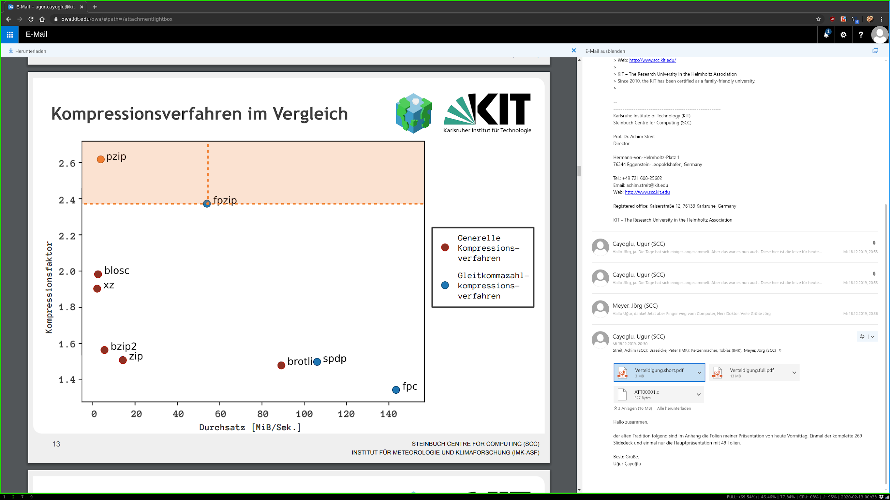
Timeline
Past
Compression Factor
Understanding the information and intrinsic structure of the data
Domain knowledge
<number>
STEINBUCH CENTRE FOR COMPUTING (SCC) INSTITUTE FOR METEOROLOGY AND CLIMATE RESEARCH (IMK-ASF)
Breakfast Meeting on 2020/02/13 by Ugur Cayoglu

Slide 27
Timeline
Past
Present
Future
Far Future
Compression Factor
Throughput
Compression Factor
Throughput
Understanding the information and intrinsic structure of the data
Research of data structures and algorithms
AI/ML methods for understanding of interdependencies
…
Domain knowledge
Applied computer science
Custom + related scientific field
…
<number>
STEINBUCH CENTRE FOR COMPUTING (SCC) INSTITUTE FOR METEOROLOGY AND CLIMATE RESEARCH (IMK-ASF)
Breakfast Meeting on 2020/02/13 by Ugur Cayoglu

Slide 28
Workflow for optimizing throughput or compression factor
Pick a target
Profile
Change code
Select use case
Benchmark
Good enough ?
Yes
No
Source [C]
<number>
STEINBUCH CENTRE FOR COMPUTING (SCC) INSTITUTE FOR METEOROLOGY AND CLIMATE RESEARCH (IMK-ASF)
Breakfast Meeting on 2020/02/13 by Ugur Cayoglu

Slide 29
Profiling and Benchmarking in this context
Profiling: Analysis of the program as a whole (might be split down to function level)
Benchmarking: Comparison of evolutions/versions of functions
<number>
STEINBUCH CENTRE FOR COMPUTING (SCC) INSTITUTE FOR METEOROLOGY AND CLIMATE RESEARCH (IMK-ASF)
Breakfast Meeting on 2020/02/13 by Ugur Cayoglu

Slide 30
Profiling and Benchmarking in this context
Profiling: Analysis of the program as a whole (might be split down to function level)
Benchmarking: Comparison of evolutions/versions of functions
main()
generate_histogram()
print_histogram()
<number>
STEINBUCH CENTRE FOR COMPUTING (SCC) INSTITUTE FOR METEOROLOGY AND CLIMATE RESEARCH (IMK-ASF)
Breakfast Meeting on 2020/02/13 by Ugur Cayoglu

Slide 31
Profiling and Benchmarking in this context
Profiling: Analysis of the program as a whole (might be split down to function level)
Benchmarking: Comparison of evolutions/versions of functions
generate_histogram()
fast_histogram()
instant_histogram()
<number>
STEINBUCH CENTRE FOR COMPUTING (SCC) INSTITUTE FOR METEOROLOGY AND CLIMATE RESEARCH (IMK-ASF)
Breakfast Meeting on 2020/02/13 by Ugur Cayoglu

Slide 32
Profiling and Benchmarking in this context
Profiling: Analysis of the program as a whole (might be split down to function level)
hyperfine (time)
valgrind (time + memory)
gnu time (time + memory)
Definitely worth looking into …
flamegraph
perf
*not-perf
*cargo-instruments
based on [C]
<number>
STEINBUCH CENTRE FOR COMPUTING (SCC) INSTITUTE FOR METEOROLOGY AND CLIMATE RESEARCH (IMK-ASF)
Breakfast Meeting on 2020/02/13 by Ugur Cayoglu

Slide 33
Profiling and Benchmarking in this context
Benchmarking: Comparison of evolutions/versions of functions
Very specific for each programming language
No general recommendation possible
Rust: criterion
<number>
STEINBUCH CENTRE FOR COMPUTING (SCC) INSTITUTE FOR METEOROLOGY AND CLIMATE RESEARCH (IMK-ASF)
Breakfast Meeting on 2020/02/13 by Ugur Cayoglu

Slide 34
Demo time
Profile I/O of my laptop
First generate some random data
Copy this data from a to b
Profile different copy commands
cp
dd
rsync
Applications we will use
hyperfine (time)
valgrind (time + memory)
gnu time (time + memory)
<number>
STEINBUCH CENTRE FOR COMPUTING (SCC) INSTITUTE FOR METEOROLOGY AND CLIMATE RESEARCH (IMK-ASF)
Breakfast Meeting on 2020/02/13 by Ugur Cayoglu

Slide 35
That’s all folks
Source [Z]
<number>
STEINBUCH CENTRE FOR COMPUTING (SCC) INSTITUTE FOR METEOROLOGY AND CLIMATE RESEARCH (IMK-ASF)
Breakfast Meeting on 2020/02/13 by Ugur Cayoglu

Slide 36
Sources
[Z] Calvin Photoshoot
[A] Greece Olympia Marble Statue
[B] https://drawingacademy.com/drawing-progress
[C] https://fosdem.org/2020/schedule/event/rust_optimizing_rav1e/
<number>
STEINBUCH CENTRE FOR COMPUTING (SCC) INSTITUTE FOR METEOROLOGY AND CLIMATE RESEARCH (IMK-ASF)
Breakfast Meeting on 2020/02/13 by Ugur Cayoglu

